Slide 1
CIS 4930/6930-002 Data Visualization
TABULAR DATA
Paul Rosen
Assistant Professor
University of South Florida
slides credits Miriah Meyer (U of Utah)

Slide 2
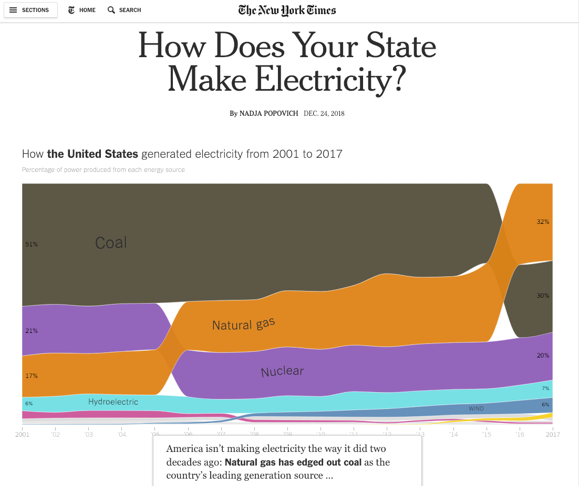

Slide 3
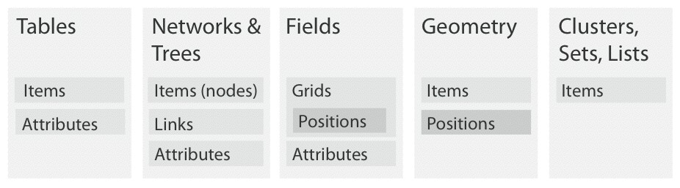
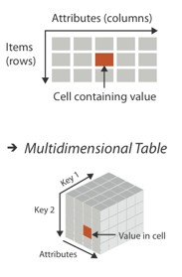
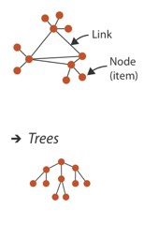
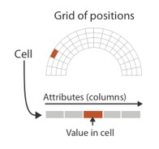
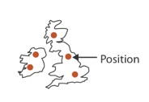
dataset types

Slide 4
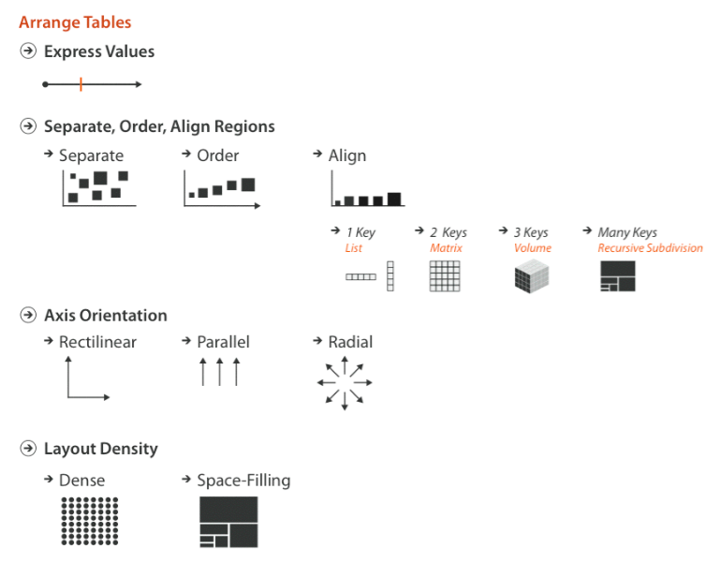

Slide 5
arrange is the focus of all four design choices for tabular data

Slide 6
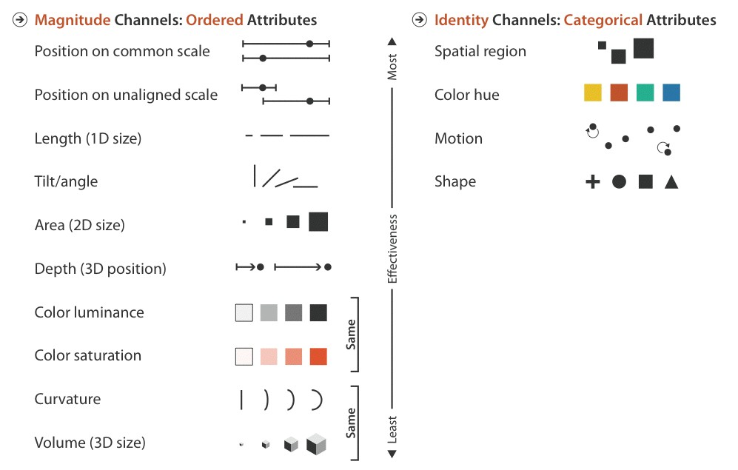
spatial channels are the most eﬀective for all attribute types

Slide 7
Single Key, Single Value

Slide 8
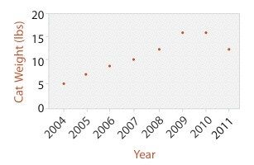
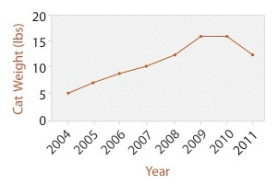
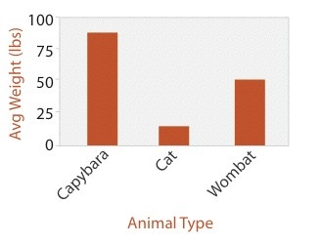
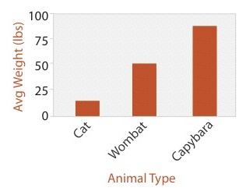
encode one key attribute
bar, dot, & line charts

Slide 9
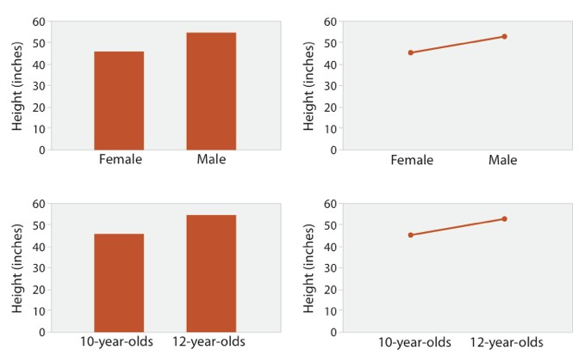
don’t use line charts for categorical attributes!
ok: “Men are taller than women (on average)”
bad: “The more male a person is, the taller he/she is”

Slide 10
don’t use line charts for categorical attributes!
ok: “Men are taller than women (on average)”
bad: “The more male a person is, the taller he/she is”
ok: “Twelve year olds are taller than ten year olds”
ok: “Height increases with age”

Slide 11
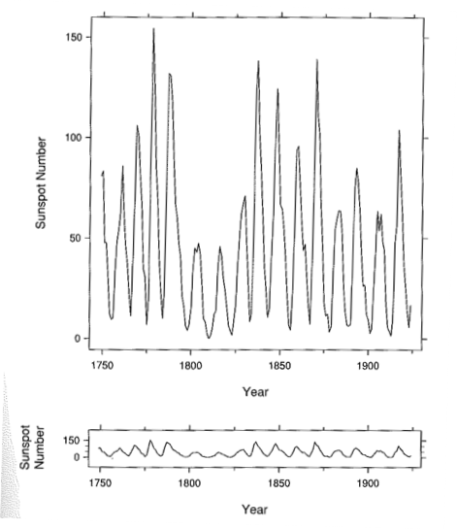
Cleveland 1994
Bank to 45°
The aspect ratio of a graph is an important factor for judging rate of change.
perceptual principle: most accurate angle judgment is at 45°
Cleveland 1994

Slide 12
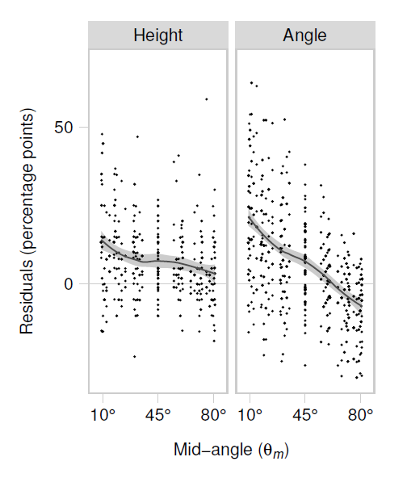
Counter-Point
Talbot 2012
people use two different strategies to estimate slope—angle and height
slope angle accuracy NOT minimized at 45°
Talbot 2012/2013

Slide 13
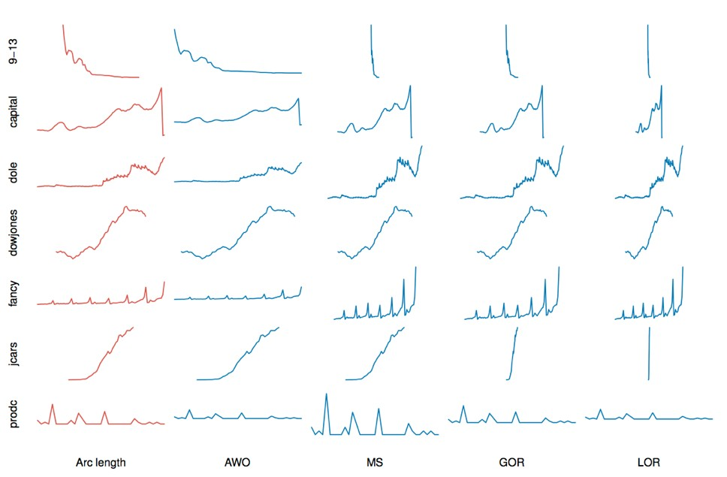
Talbot 2011

Slide 14
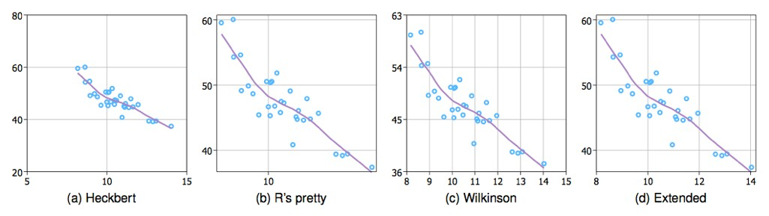
Tick Placement
Ticks help in user interpretation of data, but too much may hinder

Slide 15
AUTOMATIC TICKS
optimization of label formatting, font size, and orientation
placement based on simplicity, coverage, granularity, and legibility
Talbot 2010

Slide 16
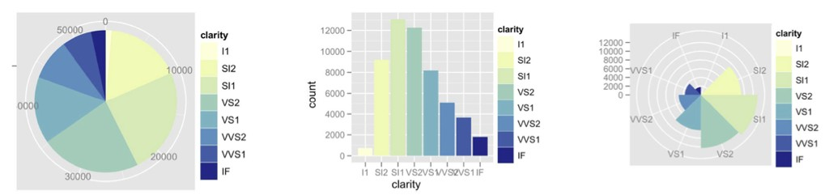
pie charts: take care with accuracy

Slide 17
2 keys, 1 value

Slide 18
encode using two keys: heatmap
uses heatmap representation
matrix layout using keys
encode values with color
often augmented with clustering

Slide 19
encode using two keys: heatmap
uses heatmap representation
matrix layout using keys
encode values with color
often augmented with clustering
0.2 | 0.4 | 1 | 1 | 1 | 0.8
1 | 0 | 0 | 0 | 1 | 1
0.7 | 0.8 | 1 | 1 | 0.8 | 0.6
1 | 0 | 0.2 | 0.5 | 1 | 1
0.5 | 0.8 | 0.5 | 0.3 | 0.5 | 0.8
0.7 | 0.5 | 0.8 | 0.7 | 1 | 1
1 | 0.3 | 0.4 | 1 | 1 | 1
0.5 | 0 | 0 | 0.7 | 0.5 | 0.3

Slide 20
encode using two keys: heatmap
uses heatmap representation
matrix layout using keys
encode values with color
often augmented with clustering
0.2
0.4
1
1
1
0.8
1
0
0
0
1
1
0.7
0.8
1
1
0.8
0.6
1
0
0.2
0.5
1
1
0.5
0.8
0.5
0.3
0.5
0.8
0.7
0.5
0.8
0.7
1
1
1
0.3
0.4
1
1
1
0.5
0
0
0.7
0.5
0.3

Slide 21
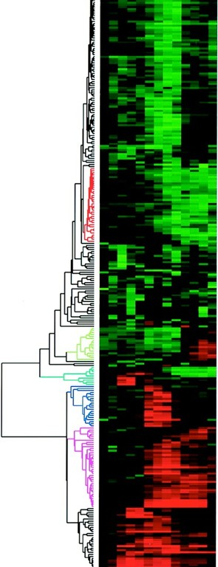
ys: heatm
encode using two keys: heatmap
uses heatmap representation
matrix layout using keys
encode values with color
often augmented with clustering
here, used on genomic data
Eisen 1998
Notes:
Genomic data

Slide 22
Multiple attributes

Slide 23
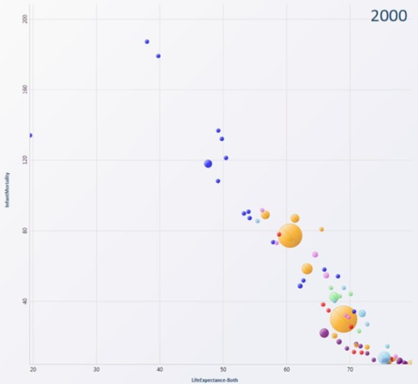
encode using scatterplots

Slide 24
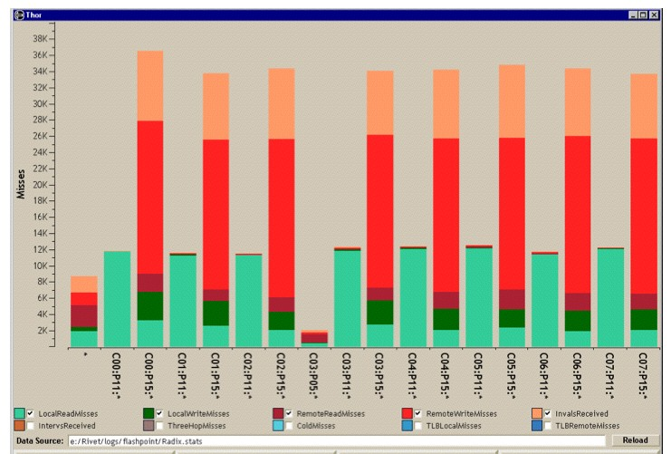
Encode using stacked bar chart

Slide 25
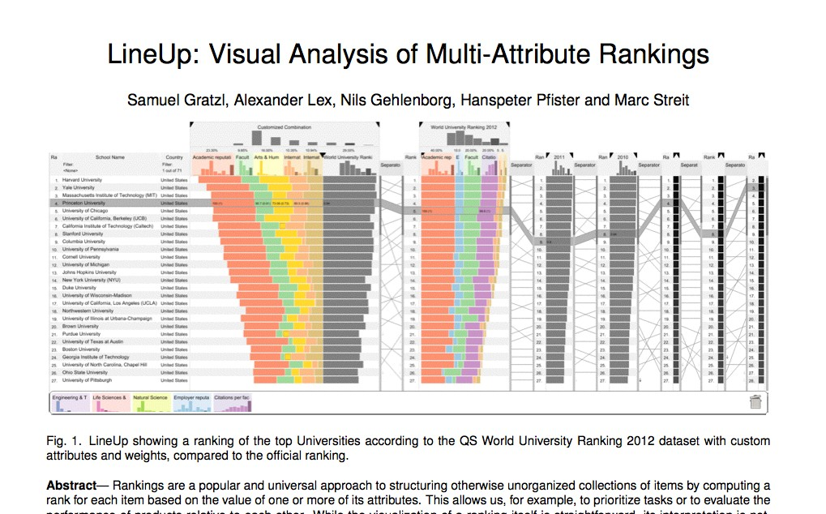
align using multiple keys

Slide 26
Challenge
rankings based on single attribute are trivial to display
when based on multiple attributes:
not clear how attributes contribute to ranking
not clear how changes to multiple attributes will affect ranking
different contexts/people/situations will rank on multiple attributes differently

Slide 27

41

Slide 28
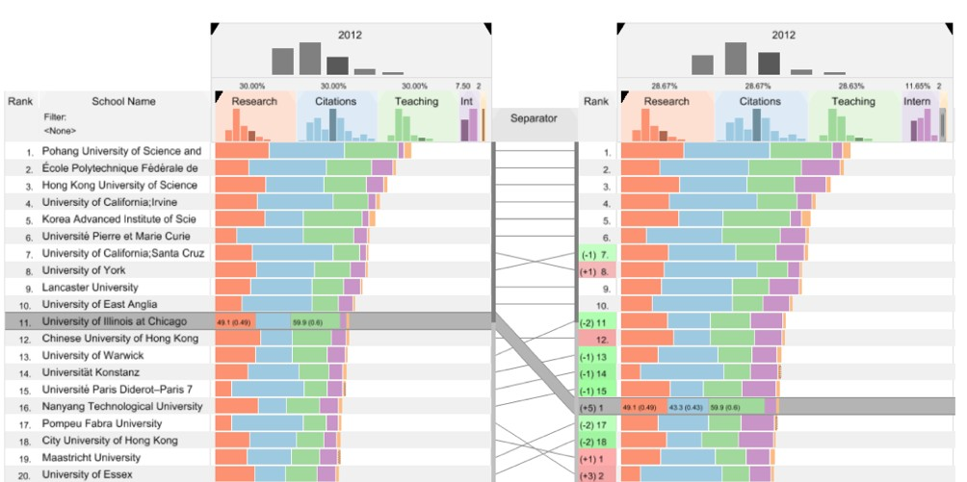
critique: what do you think?
Byron 2008

Slide 29
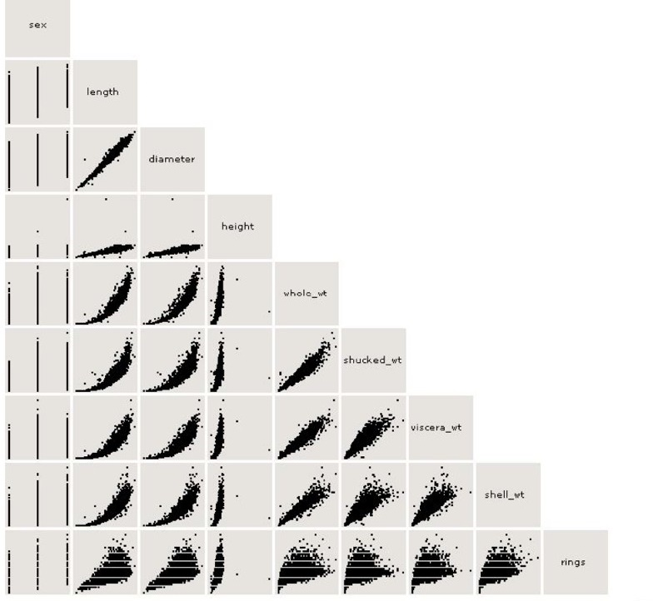
SPLOMs: scatterplot matrices
nine characteristics of Abalone (sea snails)

Slide 30
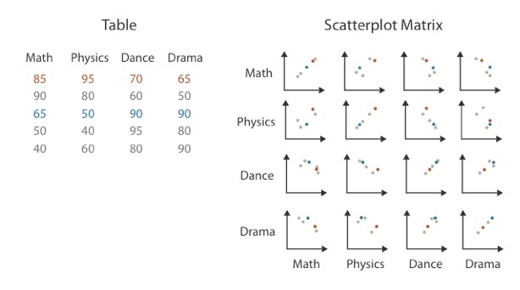
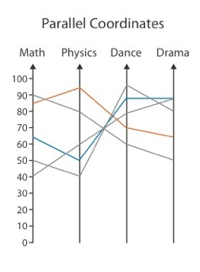
parallel coordinates
scatterplot limitation: visual representation with orthogonal axes
can show only two attributes with spatial position channel
alternative: line up axes in parallel to show many attributes with position
item encoded with a line with n segments
n is the number of attributes shown

Slide 31
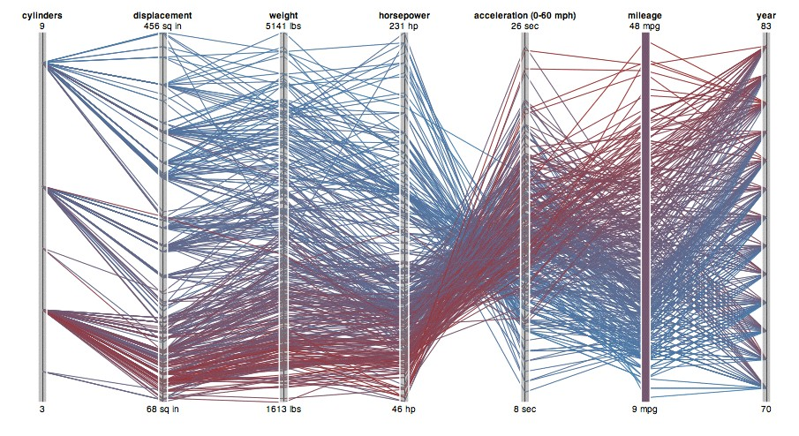
parallel coordinates
Protovis

Slide 32
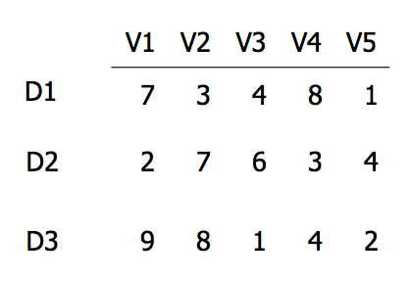
EXAMPLE

Slide 33
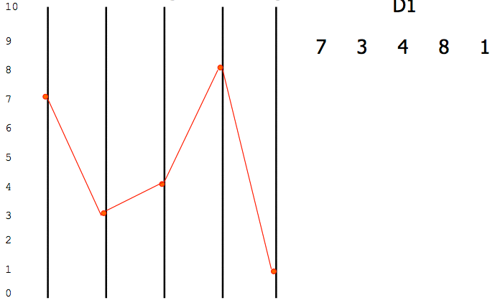
EXAMPLE
V1 V2 V3 V4 V5
D1

Slide 34
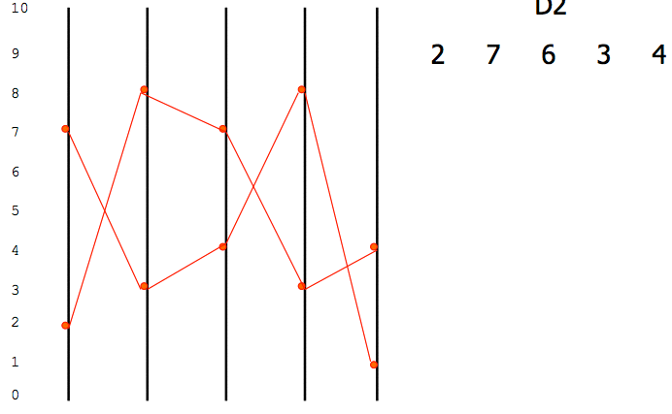
EXAMPLE
V1 V2 V3 V4 V5
D2

Slide 35
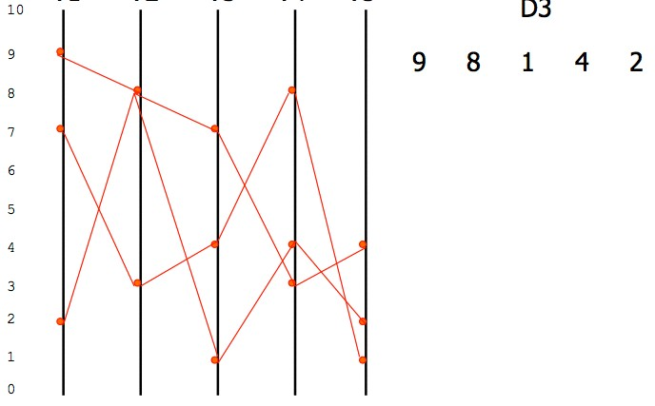
EXAMPLE
V1 V2 V3 V4 V5
D3

Slide 36
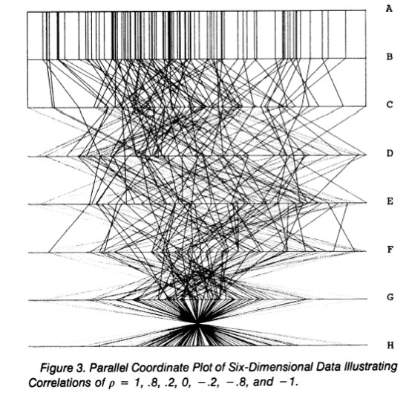
PARALLEL COORDINATES TASK
show correlation
positive correlation: straight lines
negative correlation: lines cross at a single point
Wegman 1990

Slide 37
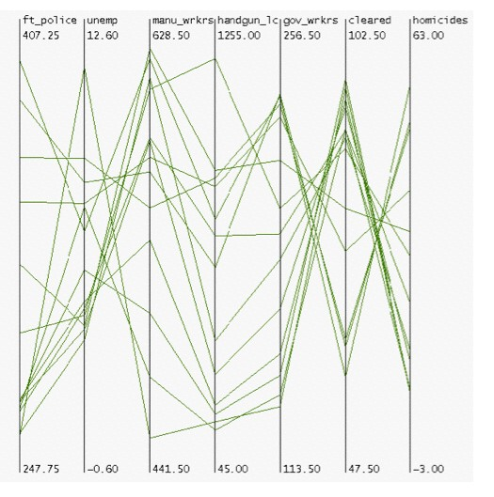
PARALLEL COORDINATES TASK
do you see any correlations?
Fua 1999

Slide 38
PARALLEL COORDINATES TASK
visible patterns only between neighboring axis pairs
how to pick axis order?
usual solution: reorderable axes, interactive exploration
same weakness as many other techniques
downside: human-powered search
not directly addressed in HPC paper
Fua 1999

Slide 39
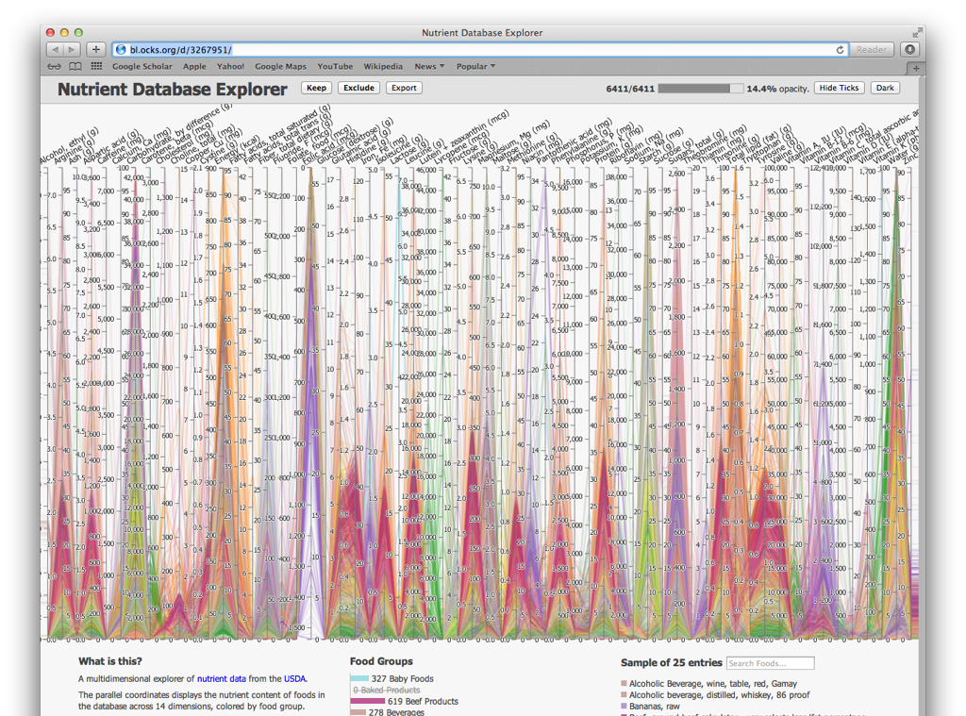
55

Slide 40
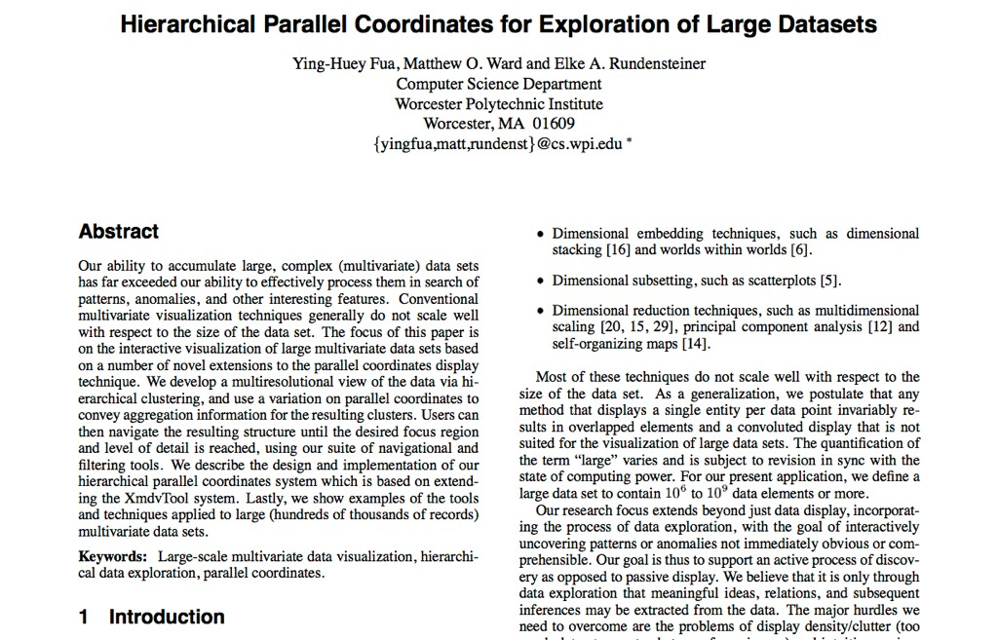

Slide 41
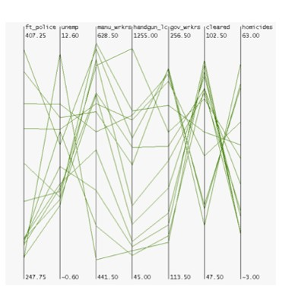
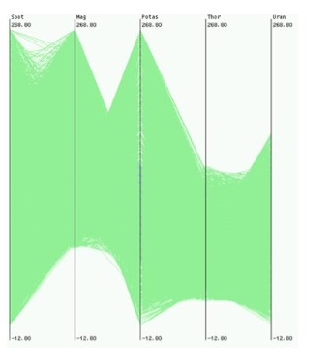
HIERARCHICAL PARALLEL COORDINATES
goal: scale up parallel coordinates to large datasets
challenge: overplotting/occlusion
Fua 1999

Slide 42
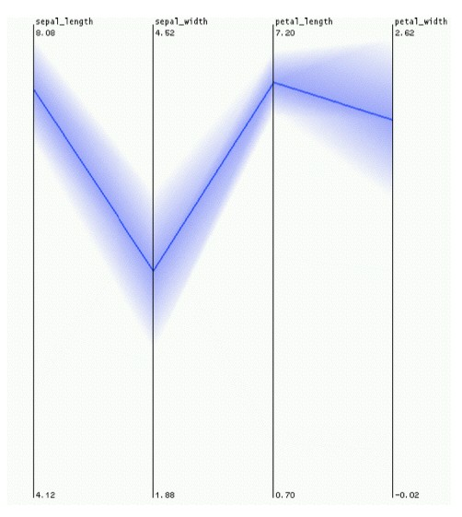
HPC: ENCODING DERIVED DATA
visual representation: variable-width opacity bands
show whole cluster, not just single item
min / max: spatial position
cluster density: transparency
mean: opaque
Fua 1999

Slide 43
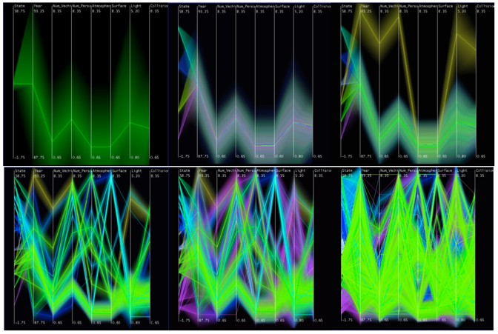
HPC: INTERACTING WITH DERIVED DATA
interactively change level of detail to navigate cluster hierarchy
Fua 1999

Slide 44
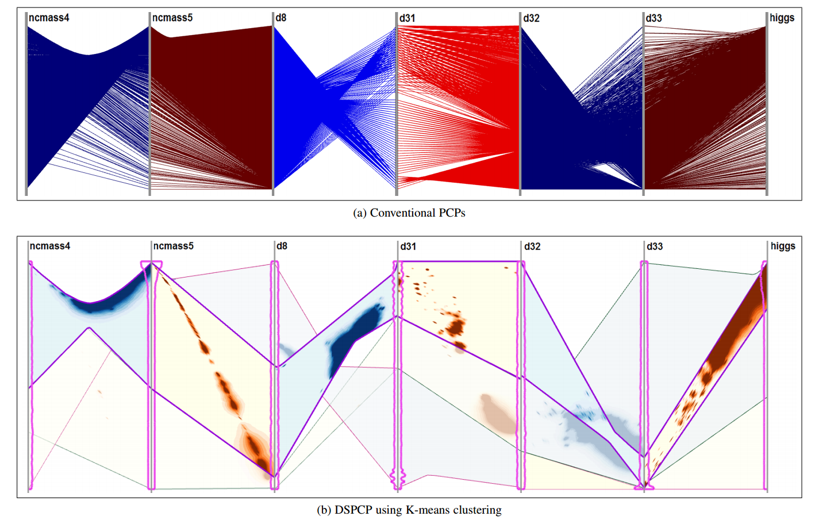
DSPCP
Cluster into groups of homogeneous behavior and represent positive and negative correlations directly
Nguyen 2017

Slide 45
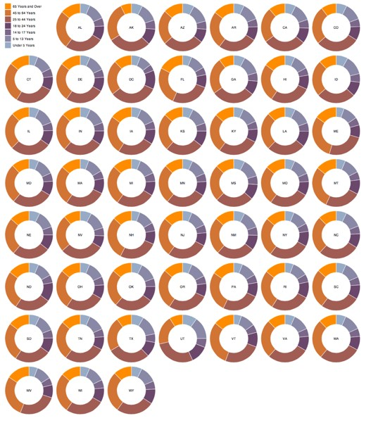
radial layouts
http://bl.ocks.org/mbostock/3888852

Slide 46
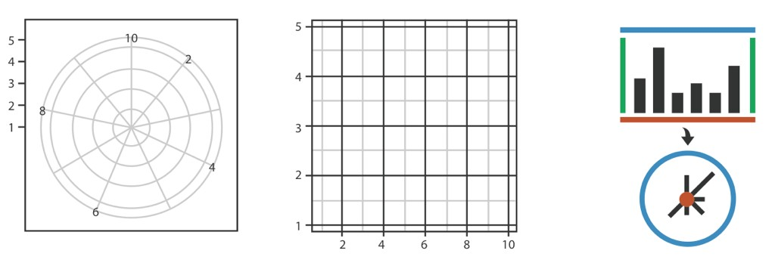
radial layouts use polar coordinates

Slide 47
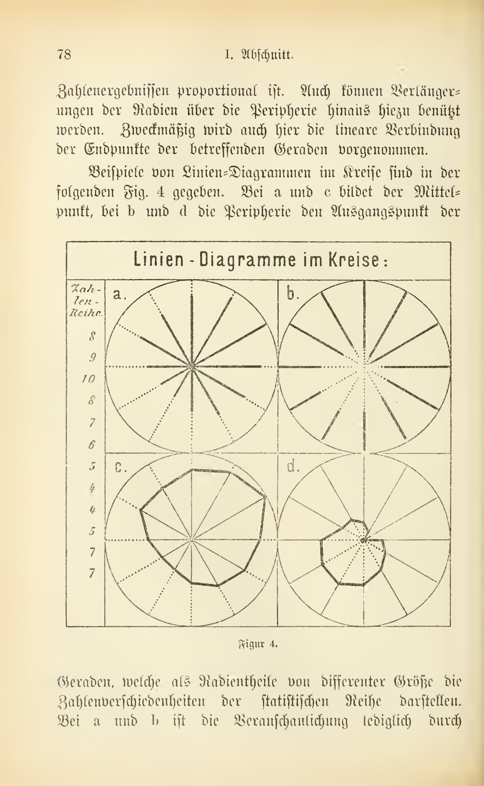
radar plot & star graph
“parallel” dimensions in polar coordinate space
best if same units apply to each axis

Slide 48
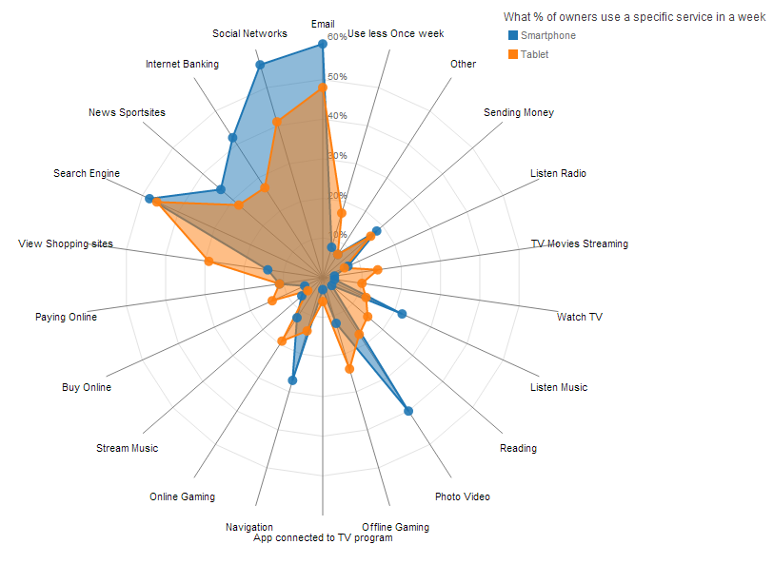
Critique: What do you think?
http://www.visualcinnamon.com/2013/09/making-d3-radar-chart-look-bit-better.html

Slide 49
dense pixel display: VisDB
represent each data item, or each attribute in an item as a single pixel
can fit as many items on the screen as there are pixels, on the order of millions
relies heavily on color coding
challenge: what’s the layout?
Keim 1994

Slide 50
relevance factor
dim. 1
dim. 2
dim. 3
dim. 4
dim. 5

Slide 51
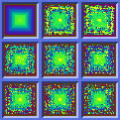
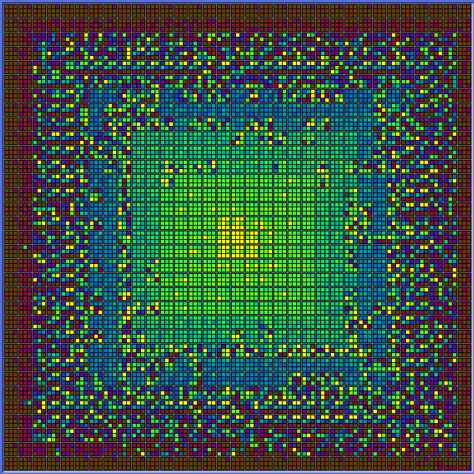
critique: what do you think?

